Slide 1
“AI for Requirement Analysis, Design, and AI-Powered Prototyping”
Transforming Software Development with AI
Presented by : Abhishek Thakur
Knowledge Associate,
CDAC Hyderabad

Slide 2
Table of Contents:
Introduction to Automated Requirements Analysis
UML Modeling
Architectural Design
AI Tools: Chat-Gpt, Plant UML, Chat UML, AI-Powered Prototype.
AI to generate prototypes and mockups from descriptions.

Slide 3


AI technologies like machine learning and natural language processing are pivotal in design. They analyze user data and preferences, enabling designers to create more relevant and tailored mockups, enhancing user experience significantly.
CDAC Hyderabad

Slide 4

INTRODUCTION TO AI IN REQUIREMENT ANALYSIS
In today's rapidly evolving software landscape, AI plays a pivotal role in enhancing requirement analysis and design processes. This presentation explores a comprehensive approach utilizing UML modeling and automated tools to improve efficiency and accuracy in software development.

Slide 5
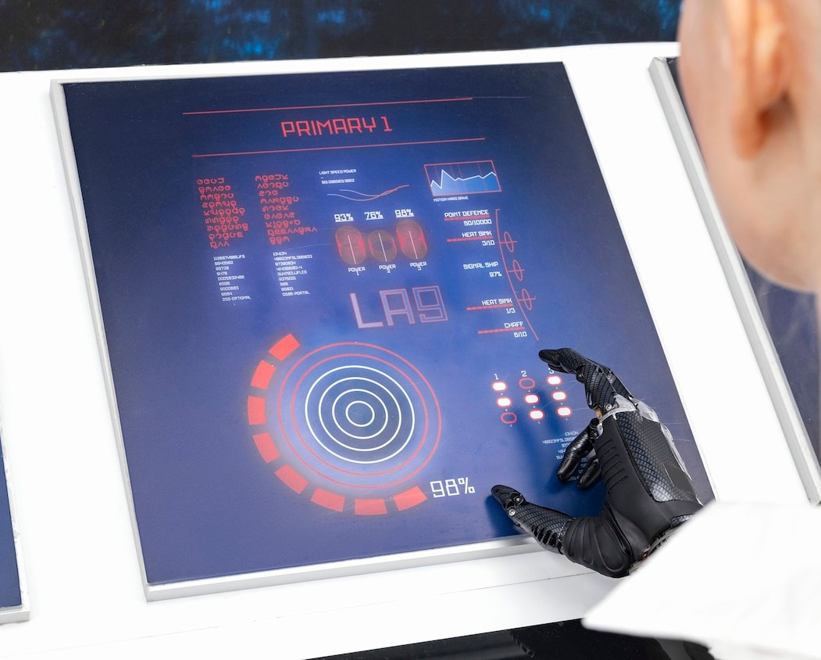
Requirement analysis is a critical phase in software development that involves gathering, validating, and documenting user needs. By leveraging AI, organizations can automate repetitive tasks, ensuring more accurate and comprehensive requirements gathering through advanced data analytics.
UNDERSTANDING REQUIREMENT ANALYSIS
AI for requirement analysis enhances project efficiency by automating data gathering, identifying stakeholder needs, and analyzing trends. It streamlines communication, reduces misunderstandings, and ensures that requirements align with business objectives, leading to more successful project outcomes and faster delivery times.

Slide 6
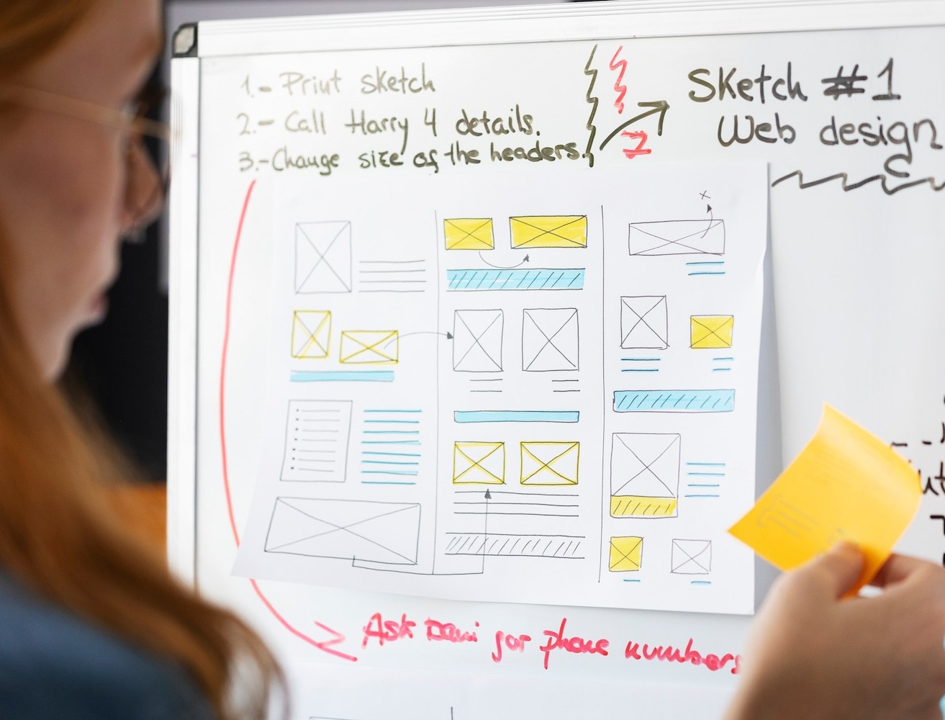
ROLE OF UML MODELING
Unified Modeling Language (UML) provides a standardized way to visualize system architecture. By incorporating AI-driven tools, we can enhance UML modeling, enabling better communication among stakeholders and facilitating a clearer understanding of system requirements and design.

Slide 7
Key Objectives of UML:
Visualization
Specification
Documentation
Design validation
Communication
Flexibility & Enhanced Communication

Slide 8
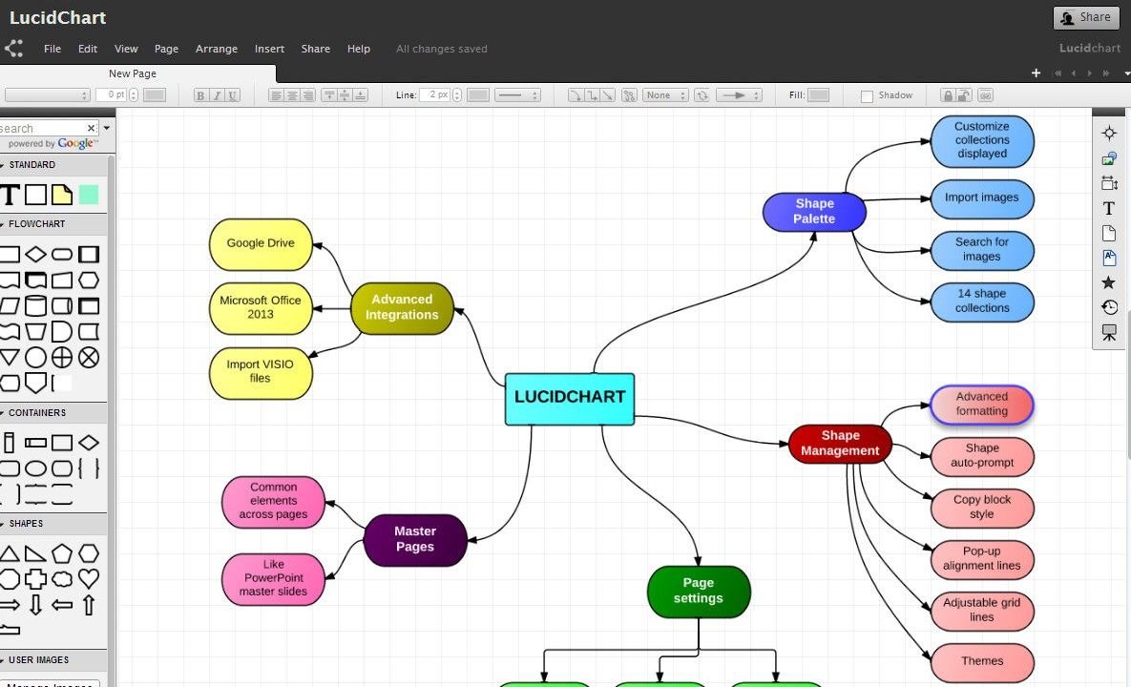
AUTOMATED TOOLS FOR EFFICIENCY
Utilizing automated tools in requirement analysis and design helps in reducing human error and increasing productivity. These tools can assist in generating documentation, validating requirements, and ensuring compliance with standards, thereby streamlining the development process.
Lucidchart is a user-friendly platform for creating diagrams and ﬂowcharts. Its small text functionality allows users to add detailed annotations without cluttering the visual space, enhancing clarity and communication in presentations and collaborative projects. Ideal for professionals seeking clients visual solutions.
A Lucidchart
CDAC Hyderabad

Slide 9
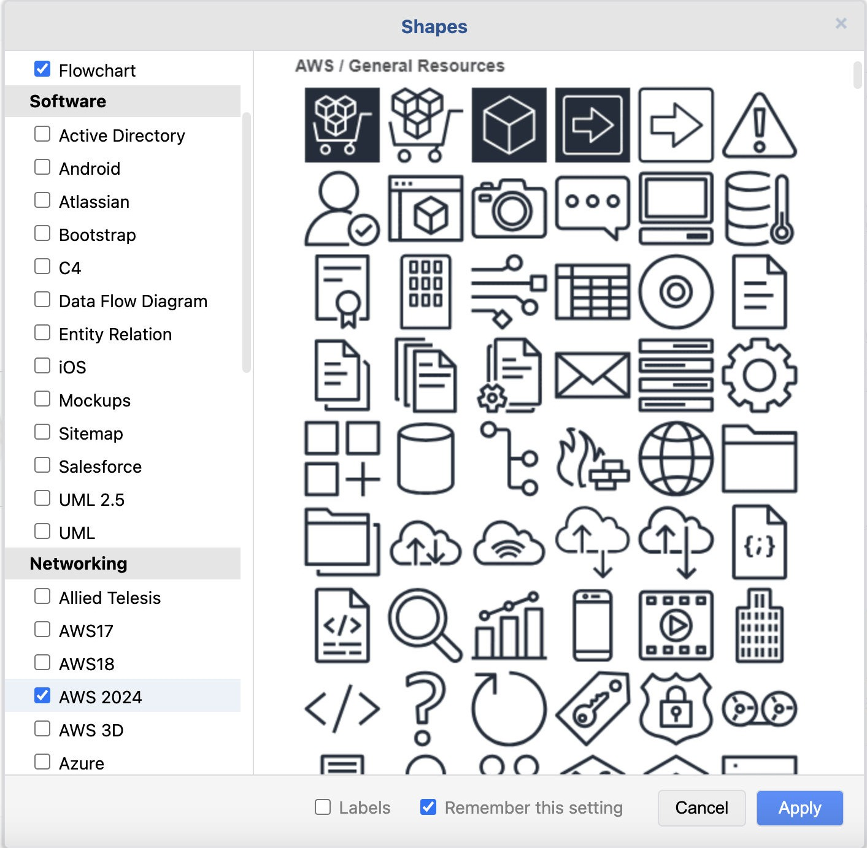
DRAW.IO
Draw.io, now known as diagrams.net, is a free online diagramming tool. It allows users to create ﬂowcharts, network diagrams, and more. With an intuitive interface, it supports collaboration and integrates with platforms like Google Drive and GitHub, enhancing productivity in visual communication.
Overview of Draw.io Interface
CDAC Hyderabad

Slide 10
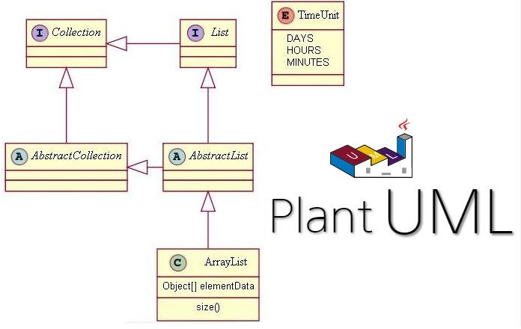
PLANT UML
PlantUML is a tool that allows users to create UML diagrams from plain text descriptions. It supports various diagram types, including sequence, use case, and class diagrams, making it a valuable resource for software design and documentation. Its simplicity enables quick visualization of complex systems.
An example of a PlantUML

Slide 11

CHALLENGES AND CONSIDERATIONS
While integrating automated tools offers numerous benefits, challenges such as data privacy, tool compatibility, and the need for training must be addressed.
Organizations must carefully evaluate these factors to ensure a successful implementation of AI in their processes.

Slide 12
Takeaways from requirement Analysis
In conclusion, enhancing requirement analysis and design through UML modeling presents significant opportunities for improvement in software development.
Future advancements in AI technology will likely further streamline these processes, promoting more effective and efficient project outcomes.
CDAC Hyderabad

Slide 13

In today's fast-paced world, leveraging AI is crucial for efficient prototype and mockup generation. This presentation explores how artificial intelligence transforms design processes, enhancing creativity and productivity while reducing time and costs.
CDAC Hyderabad

Slide 14
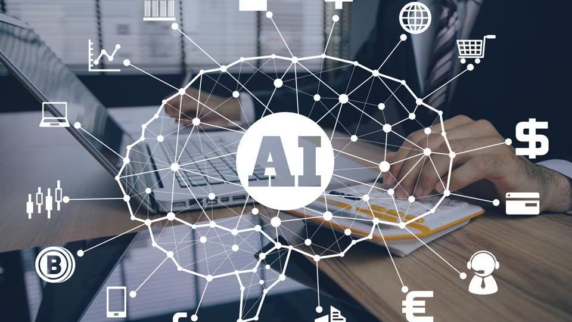
Utilizing AI in prototyping offers numerous benefits, including speed, accuracy, and iteration.
Designers can generate multiple prototypes quickly, test various ideas, and refine them based on real-time feedback, improving overall design quality.
CDAC Hyderabad

Slide 15
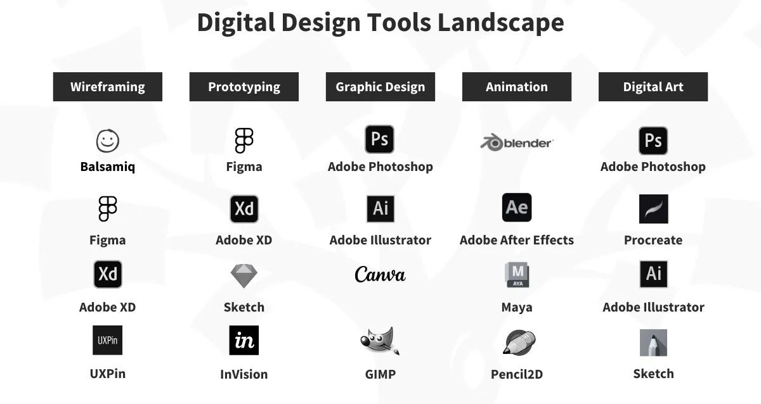
AI Tools for Designers
Several AI tools, such as Figma, Sketch, and Adobe Sensei, empower designers to create prototypes more efficiently. These tools automate repetitive tasks, allowing designers to focus on creativity and innovation in their projects.
CDAC Hyderabad

Slide 16
Role of AI in Architectural Design
Automation of Design Process
Performance Optimization
Error Detection & Validation
Knowledge Reuse
Simulation & Prediction

Slide 17
Case Studies in AI Design
In the healthcare industry, a robust Supply Chain Management System (SCMS) is vital to ensure the timely availability of critical medical supplies, pharmaceuticals, and equipment. The proposed system should include real-time tracking to monitor the location and condition of sensitive items such as vaccines, which require specific temperature ranges during transit. Shipment updates should provide timely notifications on the status of orders, delays, and estimated delivery times to ensure seamless coordination between suppliers, hospitals, and clinics. Furthermore, the integration of predictive analytics can enable healthcare providers to forecast demand for essential supplies based on historical data, seasonal trends, and potential emergency scenarios, thereby preventing stockouts or wastage. This system will enhance supply chain transparency, ensure compliance with regulations, and improve patient care by ensuring that medical facilities are always adequately equipped.

Slide 18

Future of AI in Design
The future of design is poised for a revolution with AI advancements. As technology evolves, expect more intelligent tools that enhance collaboration, creativity, and efficiency, reshaping how designers approach their work.
CDAC Hyderabad

Slide 19

In conclusion, leveraging AI for prototype and mockup generation is not just a trend but a necessity for modern design. By embracing these technologies, designers can enhance their workﬂows, foster innovation, and ultimately deliver better products.
CDAC Hyderabad

Slide 20
Thanks!!!

